Slide 1
NUTRITION!

Slide 2
3 Necessary Macronutrients
Protein
Carbohydrates
Fats

Slide 3
What is Protein?
Protein is a macronutrient comprised of amino acid that is necessary for the growth, development, immunity and function of the human body.

Slide 4
Amino Acids
Amino Acids are the building blocks of protein
There are 22 different amino acids
9 of these are referred to as essential amino acids
Essential amino acids cannot be made by the body and must come from food sources

Slide 5
Types of Protein
Complete – Any food that has all 9 essential amino acids
Sources: animal proteins, tofu, quinoa, soy
Incomplete – Do not supply all 9 essential amino acids
Sources: most plant sources including veggies, grains, beans, and nuts
Complementary – incomplete proteins that can be combined to form a complete protein
Examples: rice and beans, peanut butter and wheat toast

Slide 6
Complete or Incomplete?
complete

Slide 7
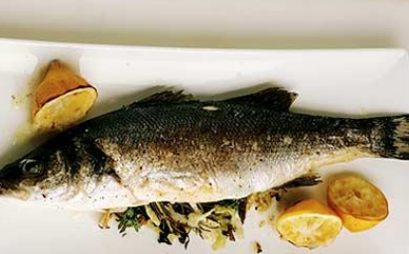
complete

Slide 8
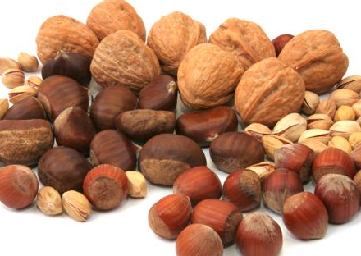
Incomplete

Slide 9
Complete

Slide 10
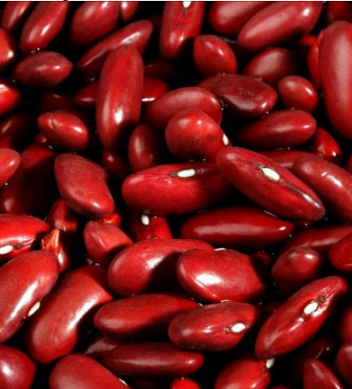
Incomplete

Slide 11
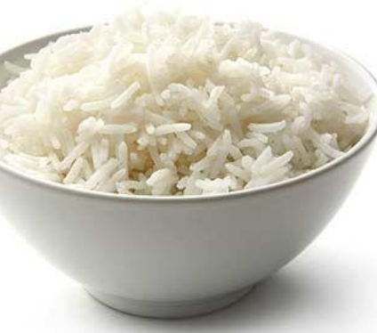
Incomplete

Slide 12
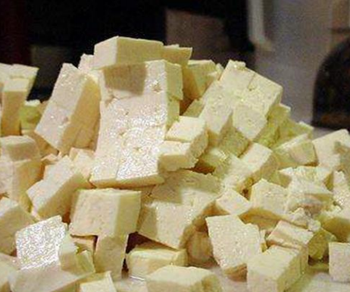
Complete

Slide 13
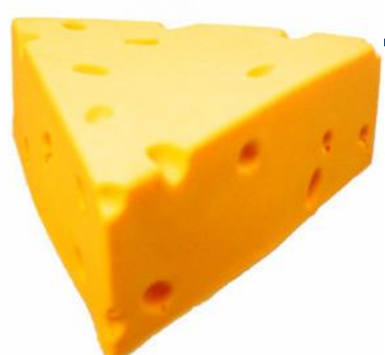
Complete

Slide 14
Complete

Slide 15
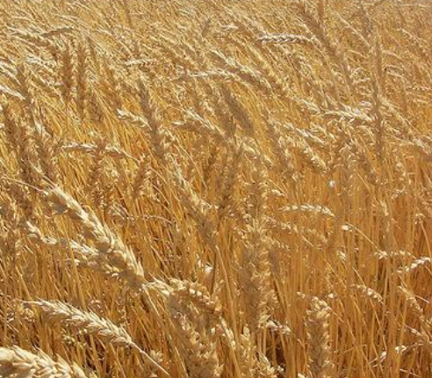
Incomplete

Slide 16
Why We Need Protein
Protein helps to…
Build Muscles, Bones and Other Body Parts
Increase Immunity
Balance pH Value
Transport Nutrient
Lose Weight
Form Enzymes

Slide 17
Too Little Protein and…
Your body breaks down protein-rich tissues Therefore, the initial effect of low protein intake can be muscle wasting accompanied by increasing weakness.
You may also experience a greater number of infections because your immune system can’t produce enough antibodies or other immune molecules.
You might become increasingly irritable and develop a skin rash and changes to your hair texture.
Extreme protein deficiency can result in shock and eventual death.

Slide 18
Too much protein and…
Eating more protein than your body needs can interfere with your health and fitness goals in a number of ways including
Weight gain and Extra Body Fat
If you eat more protein than your body requires, it will simply convert most of those calories to sugar and then fat
Stress on your kidneys
Dehydration
Leaching of important bone minerals

Slide 19
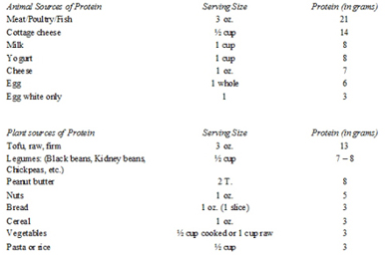
How much protein do you eat??
Write down everything that you can remember eating and drinking yesterday
Use the chart to calculate the total grams of protein you think you ate

Slide 20
How Much Protein Is Enough?
Adults in the U.S. are encouraged to get 10% to 35% of their day's calories from protein foods. That's about 46 grams of protein for women, and 56 grams of protein for men.
Americans consume anywhere from three to five times more protein than they need for optimal health, along with far too many carbohydrates and not enough healthy fats

Slide 21
Global protein intake

Slide 22
Growing Vegetarian Trend
Any Vegetarians in the Room?
Vegetarian Times Study Shows 7.3 Million Americans Are Vegetarians and an additional 22.8 Million Follow a Vegetarian-Inclined Diet.
Many Health Benefits of Vegetarianism
Research has found that vegetarians have lower rates of a number of health problems, including overweight and obesity, cardiovascular disease (CVD), hypertension, type 2 diabetes, some cancers, gallstones, kidney stones, constipation, and diverticular disease
Cautions
Vitamin B-12 Deficiency can be a serious problem
Vitamin B12 is found only in animal products, so a deficiency of this vitamin is a potential concern for anyone following a vegan or vegetarian diet or anyone who significantly restricts animal products.
Symptoms:
Weakness, tiredness, or light-headedness
Rapid heartbeat and breathing
Pale skin
Sore tongue
Easy bruising or bleeding, including bleeding gums
Stomach upset and weight loss
Diarrhea or constipation

Slide 23
Vegetarianism and the Environment
Methane (CH₄) is the second most prevalent greenhouse gas emitted in the United States from human activities.
Globally, over 60% of total CH₄ emissions come from human activities. Methane is emitted from industry, agriculture, and waste management activities
Agriculture Domestic livestock such as cattle, buffalo, sheep, goats, and camels produce large amounts of CH₄ as part of their normal digestive process. Also, when animals' manure is stored or managed in lagoons or holding tanks, CH₄ is produced. Because humans raise these animals for food, the emissions are considered human-related. Globally, the Agriculture sector is the primary source of CH₄ emissions

Slide 24
Giving up beef will reduce carbon footprint

Slide 25
Homework
Create a Food Entry in which you meet the recommended amount of protein

Slide 26
What are Carbohydrates?
CARBOHYDRATES are the body's most preferred source of energy.
They make up, by far, the largest volume (60%) of our daily food
People should eat an average of 130 g of carbohydrates daily
Your digestive system changes carbohydrates into glucose. Your body uses this sugar for energy for your cells, tissues and organs.
It stores any extra sugar in your liver and muscles as glycogen for when it is needed
The most common and abundant forms are sugars, fibers, and starches

Slide 27
Functions
Supplies the energy for the body's automatic activity and for the performance of our daily tasks.
The more physical work we perform daily, the more carbohydrates we must proportionately consume.
Plays a vital part in the digestion and the metabolism and oxidation of protein and fat.

Slide 28
Simple Carbohydrates
Also known as simple sugars
Simple carbohydrates include sugars found naturally in foods such as fruits, vegetables, milk, and milk products. They also include sugars added during food processing and refining.
Simple carbohydrates are quick energy sources, but they do not usually supply any other nutrients or fiber

Slide 29
Types of Simple Sugars
Glucose: sometimes known as blood sugar. Nearly all plant foods contain glucose.
Main type of sugar
Sucrose: commonly known as table sugar or cane sugar. Sucrose occurs in many fruits and some vegetables.
Fructose: known as fruit sugar. Most plants contain fructose, especially fruits and saps.
Maltose: known as malt sugar. Found in grains.
Lactose: commonly known as milk sugar. It is the principal carbohydrate found in milk.

Slide 30
Simple Sources
Fruit
Fruit juice
Table sugar
Honey
Soft drinks
Other sweets

Slide 31
Complex Carbohydrates
Complex carbohydrates are made up of sugar molecules that are strung together in long, complex chains
Complex carbohydrate foods provide vitamins, minerals, and fiber that are important to the health of an individual.
give you energy over a longer period of time

Slide 32
Starch
STARCH - breaks down into simple sugars.
The body has to break down all sugar/starch into glucose to use it.
Starch supplies the body with long, sustained energy.
All starchy foods are plant foods

Slide 33
Fiber
Fiber is a type of carbohydrate that the body can’t digest.. Fiber helps regulate the body’s use of sugars, helping to keep hunger and blood sugar in check.
Children and adults need at least 20 to 30 grams of fiber per day for good health
most Americans get only about 15 grams a day

Slide 34
Varieties of Fiber
Soluble fiber
dissolves in water,
can help lower glucose levels and lower blood cholesterol.
Examples: oatmeal, nuts, beans, lentils, apples and blueberries.
Insoluble fiber
does not dissolve in water
help food move through your digestive system
Examples: wheat, whole wheat bread, whole grain couscous, brown rice, legumes, carrots, cucumbers and tomatoes.

Slide 35
Complex Sources
Starch - bread, cereal, potatoes, pasta, rice, and legumes (dried peas and beans)
Fiber - bran, whole-grain foods, raw vegetables and fruit (especially the seeds and skins), legumes, nuts, seeds and popcorn

Slide 36
Good vs Bad Carbs
The amount of carbohydrate in the diet – high or low – is less important than the type of carbohydrate in the diet.
The majority of carbohydrates should come from complex carbohydrates (starches) and naturally occurring sugars, rather than processed or refined sugars
The healthiest sources of carbohydrates—unprocessed or minimally processed whole grains, vegetables, fruits and beans—promote good health by delivering vitamins, minerals, fiber, and a host of important phytonutrients
Unhealthier sources of carbohydrates include white bread, pastries, sodas, and other highly processed or refined foods. These items contain easily digested carbohydrates that may contribute to weight gain, interfere with weight loss, and promote diabetes and heart disease

Slide 37
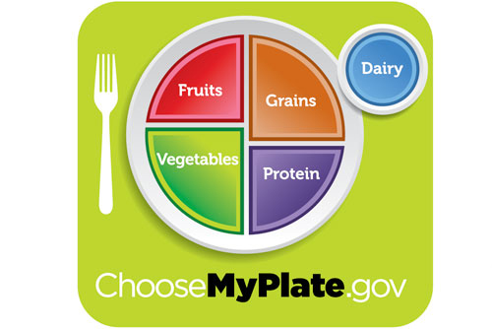
Healthy Eating Plate recommends filling most of your plate with healthy carbohydrates – with vegetables (except potatoes) and fruits taking up about half of your plate, and whole grains filling up about one fourth of your plate.

Slide 38
Recommendations
1. Start the day with whole grains. Try a hot cereal, like steel cut or old fashioned oats (not instant oatmeal), or a cold cereal that lists a whole grain first on the ingredient list and is low in sugar. A good rule of thumb: Choose a cereal that has at least 4 grams of fiber and less than 8 grams of sugar per serving.
2. Use whole grain breads for lunch or snacks. Confused about how to find a whole-grain bread? Look for bread that lists as the first ingredient whole wheat, whole rye, or some other whole grain —and even better, one that is made with only whole grains, such as 100 percent whole wheat bread.
3. Also look beyond the bread aisle. Whole wheat bread is often made with finely ground flour, and bread products are often high in sodium. Instead of bread, try a whole grain in salad form such as brown rice or quinoa.
4. Choose whole fruit instead of juice. An orange has two times as much fiber and half as much sugar as a 12-ounce glass of orange juice.
5. Pass on potatoes, and instead bring on the beans. Rather than fill up on potatoes – which have been found to promote weight gain – choose beans for an excellent source of slowly digested carbohydrates. Beans and other legumes such as chickpeas also provide a healthy dose of protein.

Slide 39
Favorite Carbs

Slide 40
High Carb Foods to Avoid

Slide 41
Carbo Loading
Carb loading is a strategy used by runners to maximize carbohydrate intake for muscle energy storage in preparation for a long run or race
The purpose of carbohydrate loading is to give you the energy to complete an endurance event with less fatigue
Carbohydrate loading is most beneficial if you're an endurance athlete — such as a marathon runner, swimmer or cyclist — preparing for an event that will last 90 minutes or more.
Other athletes generally don't need carbohydrate loading

Slide 48
Celiac Disease
Celiac disease is a disorder where the ingestion of gluten (a protein found in wheat, rye and barley) leads to damage in the small intestine.
It is estimated to affect 1 in 100 people worldwide.
Two and one-half million Americans are undiagnosed and are at risk for long-term health complications.
Leads to nutrients not being absorbed properly into the body.
Celiac disease is hereditary

Slide 49
Gluten Free Diet
The gluten-free diet is a treatment for celiac disease
Allowed foods
Beans, seeds, nuts in their natural, unprocessed form
Fresh eggs
Fresh meats, fish and poultry (not breaded, batter-coated or marinated)
Fruits and vegetables
Most dairy products

Slide 50
Gluten Free Cont.
Avoid unless labeled 'gluten-free' In general, avoid the following foods unless they're labeled as gluten-free or made with corn, rice, soy or other gluten-free grain:
Beer
Breads
Cakes and pies
Candies
Cereals
Cookies and crackers
Croutons
French fries
Gravies
Imitation meat or seafood
Matzo
Pastas
Processed luncheon meats
Salad dressings
Sauces, including soy sauce
Seasoned rice mixes
Seasoned snack foods, such as potato and tortilla chips
Self-basting poultry
Soups and soup bases
Vegetables in sauce
On average, gluten-free products were 242% more expensive than regular products

Slide 51
Activities
Review
labels

Slide 52
Carbohydrates
http://fnic.nal.usda.gov/food-composition/macronutrients
http://www.factmonster.com/ipka/A0882305.html
http://www.uen.org/Lessonplan/preview?LPid=1264

Slide 53
FATS

Slide 54
What are Fats??
Fats are nutrients that give you energy
Fat is an important part of a healthy diet
Fat should make up about 20-35% of our daily caloric intake (44-79 g)

Slide 55
Functions
Normal growth and development
Energy
fat is the most concentrated source of energy
Absorbing certain vitamins
Fat soluble vitamins - A, D, E, and K
Providing cushioning for the organs
Maintaining cell membranes
Providing taste, consistency, and stability to foods

Slide 56
Sources of Fats
meat
Poultry
Nuts
milk products
butters and margarines
Oils
Lard
Fish
grain products
salad dressings

Slide 57
Types of Fats
There are 3 types of Fats
Saturated fat
Unsaturated fat
Trans fat

Slide 58
Saturated Fat
Solid at room temperature
Mostly in animal foods, such as milk, cheese, and meat.
also in tropical oils
Foods made with butter, margarine, or shortening (cakes, cookies, and other desserts) have a lot of saturated fat.
Saturated fat can raise your cholesterol.
A healthy diet has less than 10% of daily calories from saturated fat.

Slide 59
Unsaturated Fat
Liquid at room temperature.
It is mostly in oils from plants.
Can help improve your cholesterol levels.
2 Types:
Monounsaturated fat: This fat is in avocado, nuts, and vegetable oils, such as canola, olive, and peanut oils.
Polyunsaturated fat: This type of fat is mainly in vegetable oils such as safflower, sunflower, sesame, soybean, and corn oils. Polyunsaturated fat is also the main fat found in seafood.
The two types of polyunsaturated fats are omega-3 and omega-6 fatty acids.

Slide 60
Trans Fat
This is a fat that has been changed by a process called hydrogenation.
Trans fat can raise your cholesterol, so eat as little trans fat as possible.
AHA recommends that no more than 1 percent of total daily caloric intake come from trans fat
Found in:
Processed foods.
Snack foods, such as chips and crackers.
Cookies.
Some margarine and salad dressings.
Foods made with shortening and partially hydrogenated oils.
Notes:
This process increases the shelf life of fat and makes the fat harder at room temperature. Harder fat makes crispier crackers and flakier pie crusts.

Slide 61
5 Worst Trans Fat Offenders
Margarine
Shortening
Commercial Baked Goods
Fried and Battered Foods
Coffee Creamers

Slide 62
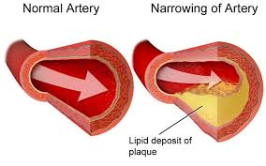
Too much fat can lead to…
High Cholesterol
A condition in which you have too much cholesterol in your blood (240 mg/dL and above)
Greater chance of getting coronary heart disease
Obesity
A complex disorder involving an excessive amount of body fat
It increases your risk of diseases and health problems such as heart disease, diabetes and high blood pressure

Slide 63
3 Ways to Avoid Bad Fats
1. Avoid packaged foods when possible.
Instead, choose whole foods, or foods you make at home.
2. Eat lean sources of protein, low-fat dairy foods, whole grains, legumes -- such as garbanzo beans and black beans -- and fruits and vegetables.
3. Use healthy oils such as olive, canola, and sunflower oil, and small amounts of tub margarine for cooking and flavoring foods.

Slide 64
Eat This Not That
http://www.eatthis.com/game/

Slide 65
Favorite Restaurant Items
http://www.eatthis.com/restaurant_guided_search/all/all/all/all

Slide 66
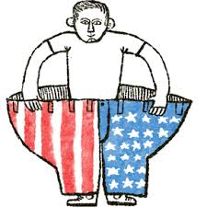
OBESITY

Slide 67
What is Obesity?
Obesity is a condition that is associated with having an excess of body fat, defined by genetic and environmental factors that are difficult to control when dieting.
Obesity is classified as having a Body Mass Index (BMI) of 30 or greater

Slide 68
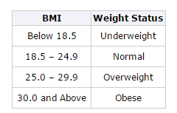
BMI
Body Mass Index (BMI) is a number calculated from a person's weight and height. BMI is a fairly reliable indicator of body fatness for most people
Formula: weight (kg) / [height (m)]²
Formula: weight (lb) / [height (in)]² x 703

Slide 69
An epidemic
https://www.youtube.com/watch?v=fzrSfz8oj0U

Slide 70
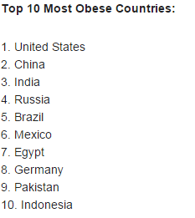
Prevalence
2014 Data

Slide 71
China is on the rise
http://blogs.wsj.com/chinarealtime/2014/05/29/as-obesity-rises-chinese-kids-are-almost-as-fat-as-americans/

Slide 72
Facts
Today two-thirds of adults and nearly one-third of children struggle with overweight and obesity.
If obesity rates stay consistent, 51 percent of the population will be obese by 2030.
Twenty years ago, no state had an obesity rate above 15 percent. Today there are 41 states with obesity rates over 25 percent
Childhood obesity has more than doubled in children and quadrupled in adolescents in the past 30 years.
The percentage of children aged 6–11 years in the United States who were obese increased from 7% in 1980 to nearly 18% in 2012. Similarly, the percentage of adolescents aged 12–19 years who were obese increased from 5% to nearly 21% over the same period.

Slide 73
Facts Continued
More than 1.4 billion adults were overweight in 2008, and more than half a billion obese
Globally, 42 million preschool children were overweight in 2013
Overweight and obesity are linked to more deaths worldwide than underweight
According to the American Cancer Society, 572,000 Americans die of cancer each year, about one-third of these cancer deaths are linked to excess body weight, poor nutrition and/or physical inactivity
obesity and overweight together are the second leading cause of preventable death in the United States
An estimated 300,000 deaths per year are due to the obesity epidemic

Slide 74
Facts
Blacks, Hispanics and Native people are much more likely to be obese than whites, according to data from the U.S. Department of Health and Human Services.
Low-income people are less likely to have access to recreation and fitness facilities, and more than 38 percent of low-income people have limited access to healthy foods
Only 4 percent of elementary schools, 8 percent of middle schools and 2 percent of high schools provide daily physical education for all students.¹
Approximately 50 percent of U.S. adults and 65 percent of adolescents do not currently get the recommended amount of daily physical activity.
In total, Americans now consume 31 percent more calories today than they did 40 years ago.

Slide 75
Economic Impact
In 2010, nearly 20 percent of the increase in U.S. health care spending (from 1987-2007) was caused by obesity.
Annual health costs related to obesity in the U.S. is nearly $200 billion, and nearly 21 percent of medical costs in the U.S. can be attributed to obesity.
Researchers estimate that if obesity trends continue, obesity related medical costs, alone, could rise by $43 to $66 billion each year in the United States by 2030.
Per capita medical spending is $2,741 higher for people with obesity than for normal weight individuals.
According to the United States Department of Agriculture, healthier diets could prevent at least $71 billion per year in medical costs, lost productivity and lost lives.²¹

Slide 76
3 main causes of obesity
Behavior
Food choices, amount of physical activity you get and the effort to maintain your health.
Americans are consuming more calories and less nutrients
While Americans are consuming more calories, they are not exercising
television, computers and other technologies discourage physical activity
Environment
Genetics
Genes can cause certain disorders which result in obesity.

Slide 77
Toxic Environment
Unnutritious foods reign.
High-fat, high-sugar foods are widely available, taste good and cost less than healthier foods.
Strips of fast-food restaurants along America's roadways
candies at the checkout counter
Serving sizes keep increasing.
All you can eat buffets
Value meals - more food for less cost.
The food industry has run amok.
Advertisements for prepackaged and fast foods flood the media
Colorfully packaged single-person servings make processed foods appealing.
Physical activity has declined.
Most Americans get less exercise than ever--walking less and driving more.

Slide 78
Then vs Now
The average restaurant meal is four times larger than it was in the 1950s
96 percent of entrees at chain restaurants exceed dietary guidelines for sodium, fat and saturated fat per meal
average adult is now 26 pounds heavier than 60 years ago

Slide 80
http://www.divinecaroline.com/self/wellness/portion-size-then-vs-now

Slide 81
http://www.susanaraab.com/consumed

Slide 82
Prices at McDonald’s
Notes:
Small fries – 46 cents/ounce
Medium fries – 41 cents/ounce
Large Fries – 3o cents/ounce
Soda small 6cent/ounce
medium 6cent/ounce
large 5cent/ounce

Slide 83
Calories in a Pound
3,500 calories equals about 1 pound (0.45 kilogram) of fat
you need to burn 3,500 calories more than you take in to lose 1 pound.
If you cut 500 calories from your typical diet each day, you'd lose about 1 pound a week (500 calories x 7 days = 3,500 calories).

Slide 84
You would need to exercise this much to burn 100 calories
http://www.sparkpeople.com/resource/fitness_articles.asp?id=1777

Slide 85
Obesity Prevention
Learn to read food labels. Pay attention to the number of servings contained in the package, then note the calorie and fat content per serving.
Compare marketplace portions to recommended serving sizes. If you eat a marketplace portion of something - say a big bagel, compare its size to what's recommended on the food pyramid.
Repackage supersize bags. Supersize bags may be more economical, but they can also encourage you to overeat. If you buy huge bags of chips or pretzels, for example, repackage the contents into smaller containers.
Share a meal. Order a couple of appetizers and split one main course with another person when you go out for a meal. Split an order of fries. Order one dessert and some extra forks.
Eat half or less. If you're not sharing a meal, eat half of what you're served and take the rest home to enjoy as another meal.
Use a smaller plate. At home, serve your meals on smaller plates. Your plate will look full, but you'll be eating less.
Skip second helpings. Eat one reasonable helping and don't go back for seconds.
Slow down! Eat slowly, to allow yourself time to feel full so you won't be as tempted to heap on a second helping.

Slide 86
Question
Should the government intervene in the obesity epidemic???
“Many people believe that dealing with overweight and obesity is a personal responsibility. To some degree they are right, but it is also a community responsibility. When there are no safe, accessible places for children to play or adults to walk, jog, or ride a bike, that is a community responsibility. When school lunchrooms or office cafeterias do not provide healthy and appealing food choices, that is a community responsibility. When new or expectant mothers are not educated about the benefits of breastfeeding, that is a community responsibility. When we do not require daily physical education in our schools, that is also a community responsibility. There is much that we can and should do together.” – Surgeon General Thatcher (2001)

Slide 87
https://www.youtube.com/watch?v=yDbocZ438f0

