Slide 1
HIV and AIDS

Slide 2
The only way to know for sure if you are infected with HIV is to get tested

Slide 3
Where did HIV come from?
Scientists identified a type of chimpanzee in West Africa as the source of HIV infection in humans.
most likely was transmitted to humans and mutated into HIV when humans hunted these chimpanzees for meat and came into contact with their infected blood.
Over decades, the virus slowly spread across Africa and later into other parts of the world.
https://www.youtube.com/watch?v=yUUlMVB751Y

Slide 4
What is HIV?
“HIV” stands for Human Immunodeficiency Virus.
H – Human – This particular virus can only infect human beings.
I – Immunodeficiency – HIV weakens your immune system by destroying important cells that fight disease and infection. A "deficient" immune system can't protect you.
V – Virus – A virus can only reproduce itself by taking over a cell in the body of its host.
You have HIV for life
Unlike most viruses, the human immune system cannot rid the body of HIV

Slide 5
HIV over time
HIV can hide in the cells of your body for long periods of time
Once the virus becomes active it attacks your T-Cells
these cells fight infections and disease
HIV can destroy so many of your CD4 cells that your body can't fight infections and diseases anymore

Slide 6
Controlling HIV
Antiretroviral Therapy (ART) keeps the level of the virus low
ART involves taking a combination of HIV medicines every day.
These HIV medicines can control the virus so that you can live a longer, healthier life and reduce the risk of transmitting HIV to others

Slide 7
Progression from HIV to AIDS
Without treatment HIV will lead to AIDS
Stage 1 – Acute Infection
Large amounts of the virus are being produced in your body
Development of flu-like symptoms
Stage 2 – Clinical Latency
HIV reproduces at low levels without producing symptoms
Can live in this stage for decades with treatment or about 10 years with no treatment
Stage 3 – AIDS
Occurs when t-cells fall below 200 cells/mm3

Slide 8
Factors that affect Progression
Factors that may shorten the time between HIV and AIDS:
Older age
Co-infection with other viruses
Poor nutrition
Severe stress
Factors that may delay the time between HIV and AIDS:
Taking antiretroviral therapy
Staying in HIV care
Closely adhering to your doctor’s recommendations
Eating healthful foods
Taking care of yourself

Slide 9
What is AIDS?
“AIDS” stands for Acquired Immunodeficiency Syndrome.
A – Acquired – AIDS is not something you inherit from your parents. You acquire AIDS after birth.
I – Immuno – Your body's immune system includes all the organs and cells that work to fight off infection or disease.
D – Deficiency – You get AIDS when your immune system is "deficient," or isn't working the way it should.
S – Syndrome – A syndrome is a collection of symptoms and signs of disease.
Not everyone that has HIV advances to AIDS

Slide 10
Symptoms of AIDS
Rapid weight loss
Recurring fever or profuse night sweats
Extreme and unexplained tiredness
Prolonged swelling of the lymph glands in the armpits, groin, or neck
Diarrhea that lasts for more than a week
Sores of the mouth, anus, or genitals
Pneumonia
Red, brown, pink, or purplish blotches on or under the skin or inside the mouth, nose, or eyelids
Memory loss, depression, and other neurologic disorders.

Slide 11
Transmission
Body Fluids that transfer HIV
Blood
Semen (cum)
Pre-seminal fluid (pre-cum)
Rectal fluids
Vaginal fluids
Breast milk
These fluids need to come into contact with mucous membrane or damaged tissue or be injected into bloodstream

Slide 12
Spreading HIV
Most Common Methods
Sex with an infected person
Sharing needles with someone that has HIV
Less Common Methods
Pregnancy, Childbirth, and Breast Feeding
Occupational Exposure
Blood Transfusions
Oral sex
Not Spread by
Air or water
Insects, including mosquitoes or ticks
Saliva, tears, or sweat
Casual contact
Drinking fountains
Toilet seats

Slide 13
Childbirth Risks
CDC recommends that all pregnant women get tested for HIV as part of their routine pregnancy care
An HIV-positive mother who is not being treated for her HIV during pregnancy, labor, or delivery has a 25% chance of passing the virus to her baby.
When an HIV-positive mother receives ART drugs during pregnancy, labor, and delivery; has her baby by Caesarian section; and avoids breastfeeding, the chance of passing the infection to her baby falls to less than 2%

Slide 14
History of the Epidemic
http://abcnews.go.com/Health/video/world-aids-day-history-epidemic-15065267

Slide 15
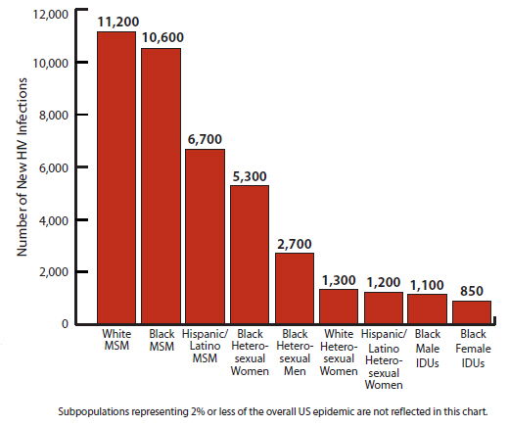
HIV in the U.S.
More than 1.1 million people in the United States are living with HIV infection, and almost 1 in 6 (15.8%) are unaware of their infection

Slide 16
HIV Globally
33.4 million are currently living with HIV/AIDS.
97% of those living with HIV reside in low and middle income countries, particularly in sub-Saharan African
Approximately 4.7 million with HIV in Asia
Approximately 2 million with HIV in Latin America
Approximately 1.5 million with HIV in in Europe
More than 25 million people have died of AIDS worldwide since the first cases were reported in 1981.
In 2008, 2 million people died due to HIV/AIDS, and another 2.7 million were newly infected

