Slide 1
Genetic Diseases

Slide 2
What is a Genetic Disease?
A genetic disease is any disease that is caused by an abnormality in an individual's genome.
Some genetic disorders are inherited from the parents, while other genetic diseases are caused by mutations in a preexisting gene.
Mutations occur either randomly or due to some environmental exposure

Slide 3
Down Syndrome
One in every 691 babies in the the United States is born with Down syndrome, making Down syndrome the most common genetic condition. Approximately 400,000 Americans have Down syndrome and about 6,000 babies with Down syndrome are born in the United States each year.
A few of the common physical traits of Down syndrome are low muscle tone, small stature, an upward slant to the eyes, and a single deep crease across the center of the palm

Slide 4
Genetics
Typically, the nucleus of each cell contains 23 pairs of chromosomes, half of which are inherited from each parent. Down syndrome occurs when an individual has a full or partial extra copy of chromosome 21.
This additional genetic material alters the course of development and causes the characteristics associated with Down syndrome.

Slide 5
Cystic Fibrosis
Cystic fibrosis is an inherited chronic disease that affects the lungs and digestive system of about 30,000 children and adults in the United States (70,000 worldwide).
A defective gene and its protein product cause the body to produce unusually thick, sticky mucus that:
clogs the lungs and leads to life-threatening lung infections; and
obstructs the pancreas and stops natural enzymes from helping the body break down and absorb food.
Life expectancy- early 40’s

Slide 6
How do you get it?
To have cystic fibrosis, a person must inherit two copies of the defective CF gene — one copy from each parent.
Carriers have only one copy of the CF gene but do not have the disease
If both parents are carriers of the CF gene their child will have a 25% chance getting CF, a 50% chance of becoming a carrier, and a 25% chance of not having CF or carrying the gene.

Slide 7
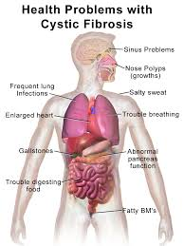
Chest Physical Therapy
Loosens the mucus in the lungs

Slide 8
Huntington’s Disease
Huntington’s Disease (HD) is an inherited brain disorder that results in the progressive loss of both mental faculties and physical control.
similar to having ALS, Schizophrenia and Alzheimer’s all at the same time
HD slowly destroys the mind and the body in what experts say is one of the worst ways to die
Symptoms usually appear between the ages of 30 to 50, and worsen over a 10 to 25 year period. Ultimately, the weakened individual dies from pneumonia, heart failure or other complication.
There is no cure or no treatment of the disease
when individuals test positive for the Huntington gene, they are effectively receiving a death sentence

Slide 9
Genetics
Everyone has the HD gene but people with the expansion of the gene develop HD and can pass it on.
Every child of a parent with HD has a 50/50 chance of inheriting the expanded gene that causes the disease.
If the child has not inherited this expanded gene, he or she will never develop the disease and cannot pass it on to their children.
http://www.youtube.com/watch?v=DiNOfTbw3AQ

Slide 10
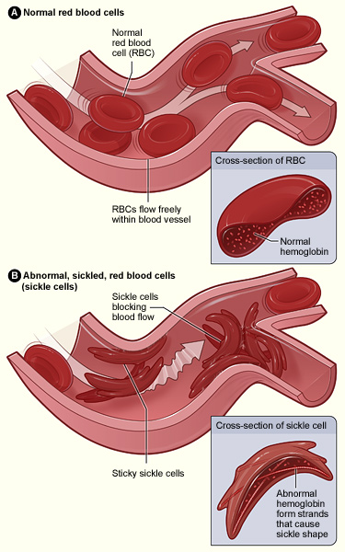
Sickle Cell Disease
Sickle cells are sticky and stiff. They can block blood flow causing pain and damage to organs and increase risk of infection
When red blood cells sickle, they break down prematurely, which can lead to anemia.
Anemia can cause shortness of breath, fatigue, and delayed growth and development in children.
Painful episodes can occur when sickled red blood cells, which are stiff and inflexible, get stuck in small blood vessels.
These episodes deprive tissues and organs of oxygen-rich blood and can lead to organ damage

Slide 11
Genetics
You must inherit two genes for sickle cells. One from each parent
Most people affected in the United States are African Americans
The disease is estimated to occur in 1 in 500 African Americans

Slide 12
Tay-Sachs Disease
Rare genetic disease that progressively kills nerve cells in the brain and the spinal chord.
Children with severe cases usually die in early childhood
Affected infants lose motor skills such as turning over, sitting, and crawling. They also develop an exaggerated startle reaction to loud noises.
As the disease progresses, children with Tay-Sachs disease experience seizures, vision and hearing loss, intellectual disability, and paralysis.

Slide 13
Genetics
It is a recessive gene so it must be inherited from both parents.
If both parents are carriers the child has a 25% chance of getting the disease
Most prevalent in people of Jewish descent

Slide 14
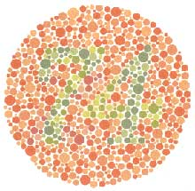
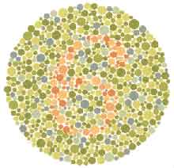
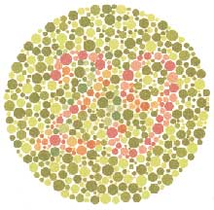
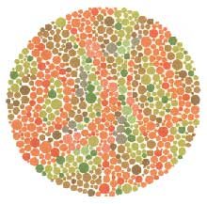
Color blindness
Inability to distinguish between different colors

Slide 15
Genetics
Inherited from mutations on the X chromosome.
Sex-linked condition
more common in boys than girls because boys only have 1 X chromosome
http://enchroma.com/test/instructions/

Slide 16
Testing
Genetic tests are tests on blood and other tissue to find genetic disorders
Over 2000 tests are available.
Doctors use genetic tests for several reasons:
Finding genetic diseases in unborn babies
Finding out if people carry a gene for a disease and might pass it on to their children
Screening embryos for disease
Testing for genetic diseases in adults before they cause symptoms
Making a diagnosis in a person who has disease symptoms
Figuring out the type or dose of a medicine that is best for a certain person
People have many different reasons for being tested or not being tested. For some, it is important to know whether a disease can be prevented or treated if a test is positive. In some cases, there is no treatment. But test results might help a person make life decisions, such as family planning or insurance coverage

Slide 17
Genetic Discrimination
Genetic discrimination occurs if people are treated unfairly because of differences in their DNA that increase their chances of getting a certain disease.
Health care providers will soon use information about each person's DNA to develop more individualized ways of detecting, treating and preventing disease. But unless this DNA information is protected, it could be used to discriminate against people.
The Genetic Information Nondiscrimination Act of 2008
federal law that protects Americans from being treated unfairly because of differences in their DNA. The new law prevents discrimination from health insurers and employers.

Slide 18
GATTACA
https://www.youtube.com/watch?v=1Q67bMYOm7E

Slide 19
Eugenics
Social philosophy advocating the improvement of human genetic traits through the promotion of higher reproduction of people with desired traits and reduced reproduction of people with less-desired or undesired traits

Slide 20
Discussion
To what extent might carrier screening and prenatal diagnosis programs be considered eugenic?
Suppose we could identify specific genes and alleles which can clearly be demonstrated to result in serious antisocial behavior, such as extreme violence or disregard for life. If this were the case, would you favor involuntary sterilization programs under any circumstances?
Imagine that we made a decision as a society to attempt to eliminate or reduce certain very serious genetic diseases with universal carrier screening and non-coercive methods such as education about the disease, counselling about options, etc. Could this be done ethically?
Suppose the diseases chosen included those which are much more prevelant in certain racial or national groups, such as sickle-cell anemia or Tay-Sachs disease. Would this raise additional concerns about racism or anti-Semitism?
Some individuals who know they carry serious diseases practice what we might call “personal eugenics” by deciding not to marry or not to have children. What do you think about this as a personal decision for an individual? What do you think about its eugenic impact on society as a whole?
Doctors frequently give patients advice about genetic screening, and both doctors and genetic counsellors play roles in advising individuals who carry a disease or whose prenatal screens indicate disease. Could the advice of these professionals constitute eugenics in some cases? What standards should they adhere to in dealing with their patients?
If we gain the ability to efficiently alter defective genes (as opposed to voluntary or involuntary reproductive control programs), is this eugenics?

